Slide 1
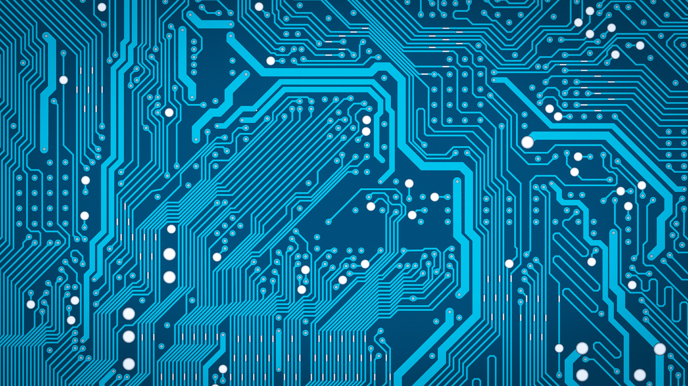

Andreea-Cristina Mazarianu
S188697
Client: Cyclosion Games (Danny Colclough)

Slide 2
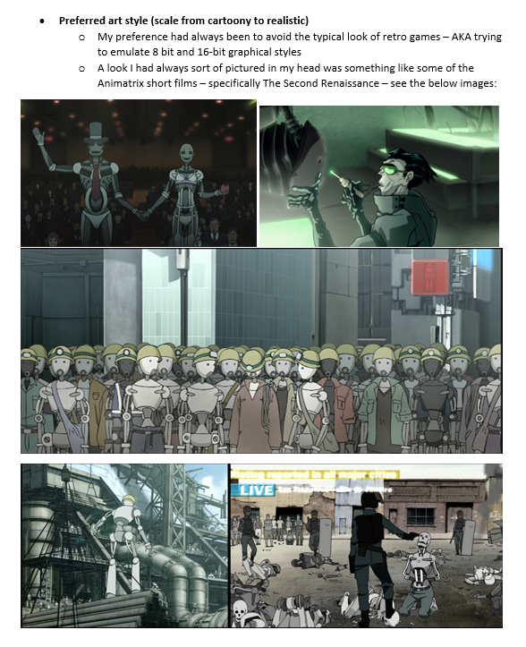
Client Brief
Platform
Computer
Game Specifications
2D, indie, adventure game
Theme
Sci-Fi, discovery, duty, redemption
Lore
Mark_2, a broken robot, wakes up in an abandoned facility and embarks on a journey of self-discovery, rebuilding himself on the way and finding out despicable truths that put the entire humanity in danger.
Style
Minimalistic, block colours, predominantly greys and tones of blue/yellows, black outline, minimal rendering to suggest materials
Deliverables
Concept art for pick-ups, main character (final and at different stages during the game), possible enemies

Slide 3
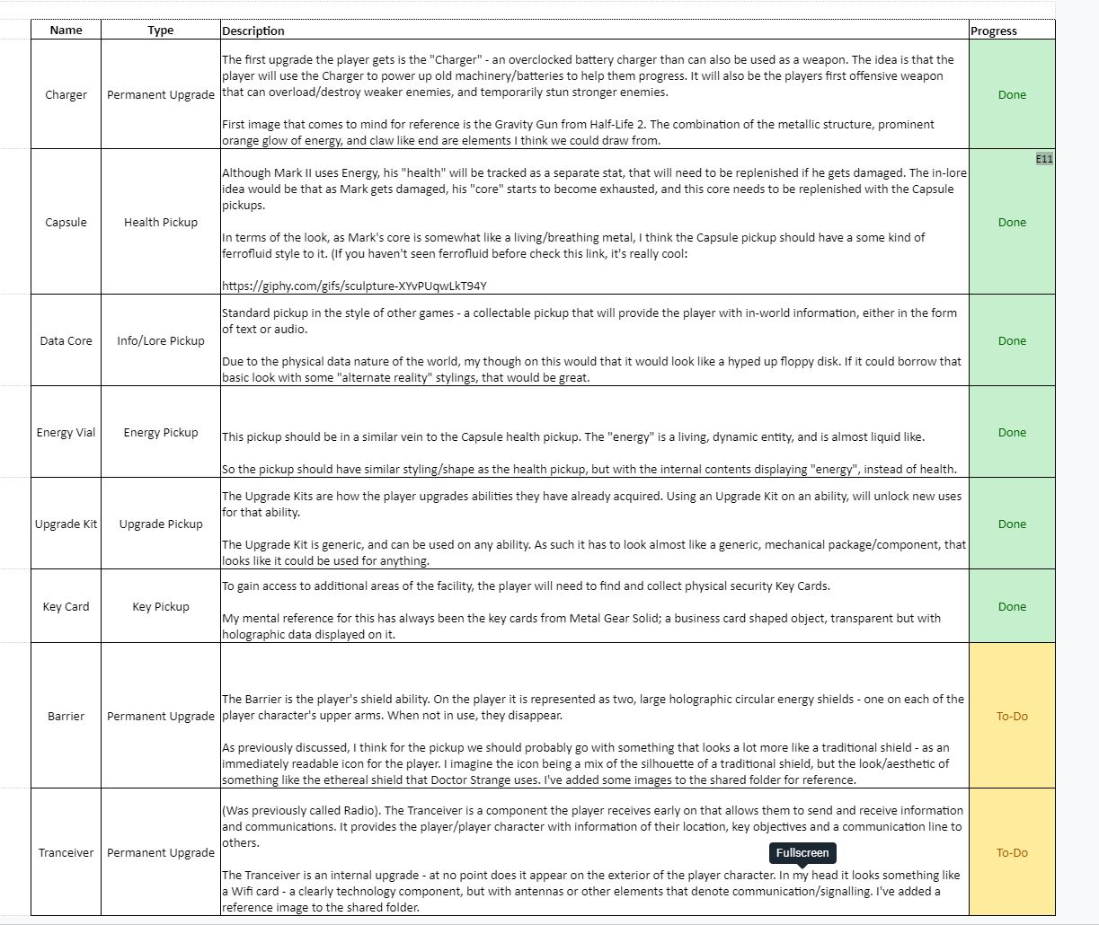
Task Prioritization
Initial:
1. Main Character
2. Character at different stages of the game (destroyed, no limbs to fully built and armored)
3. Assets - Pick-ups
4. Different types of enemies
Re-scoped:
1. Assets – Pickups
2. Main Character (final form- fully built and armored)
3. Additional: Game Logo
Each asset required: moodboards to be compiled, concept art sheet with possible designs, iterated and refined 2D sprite of the chosen design

Slide 4
Project Timeline
Deliverables:
Data Cores Moodboard/Concept and Variations/Iterated Exported Sprites
Game Logo and Thumbnail
Deliverables:
Charger Weapon Moodboard/Concept and Variations/Iterated Exported Sprite
Deliverables:
Transceiver and Shield
Concept
Deliverables:
Final Concept for the Fully Built Main Character
Week 2
Week 4
Week 6
Week 8
1st February 2020
10th May 2020
Week 1
Week 3
Week 5
Week 7
Deliverables:
Energy Vials & Upgrade Kit Moodboard/Concept and Variations/Iterated Exported Sprites
Deliverables:
Health Pick-up
Moodboard/Concept and Variations/Iterated Exported Sprite
Deliverables:
Key Card
Moodboard/Concept and Variations/Iterated Exported Sprite
Include Game Logo in all Concept Art Sheets Made
Deliverables:
Ideation sketches for the Main Character

Slide 5
Deliverables Showcase

Slide 6
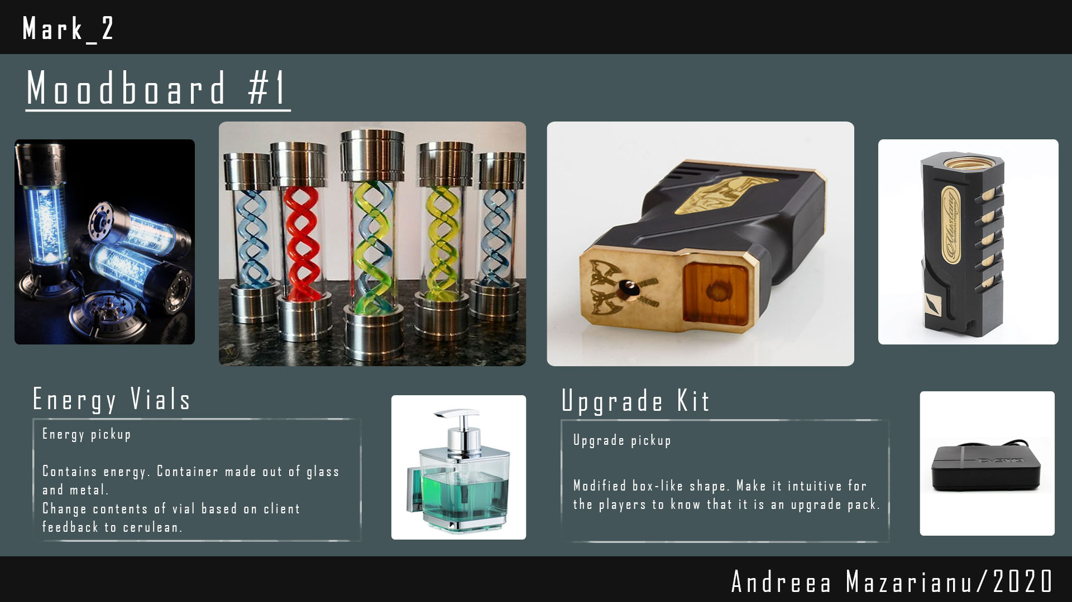
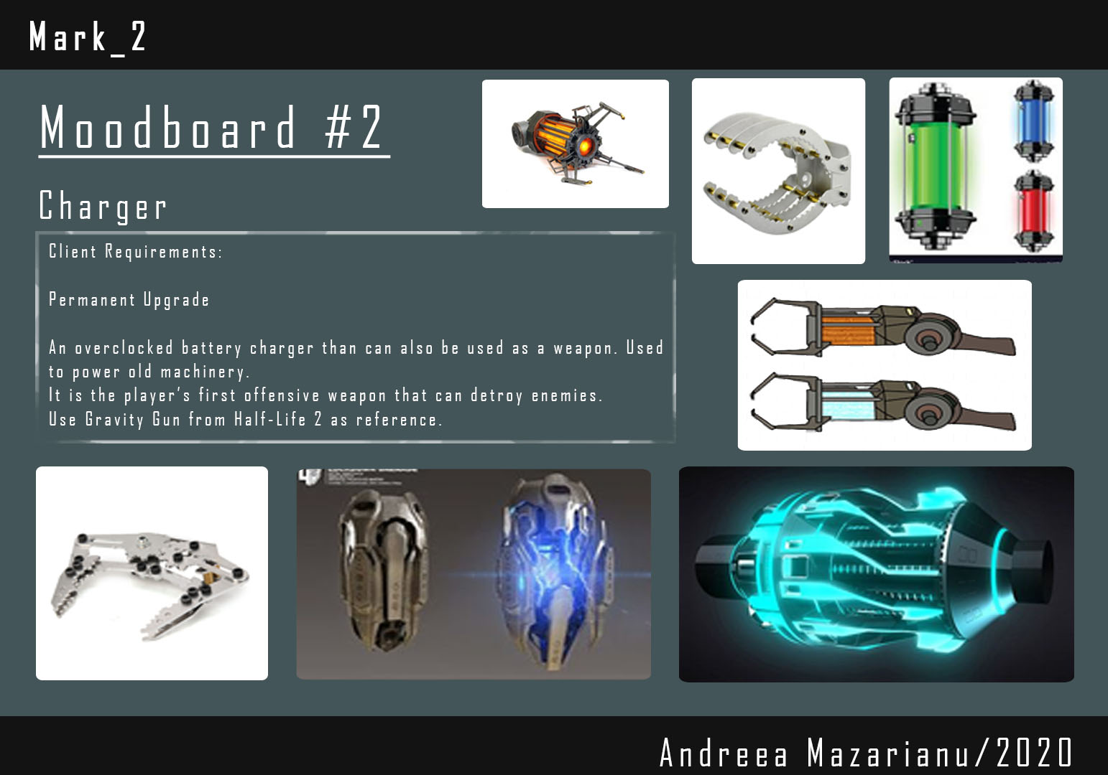
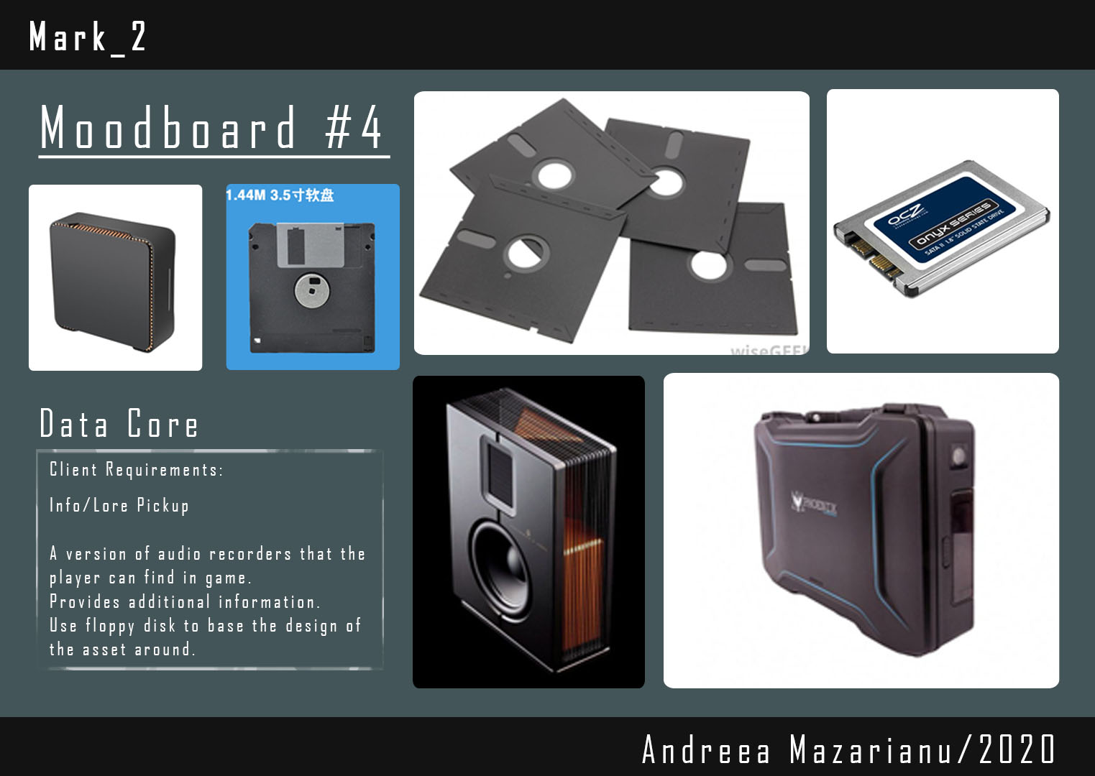
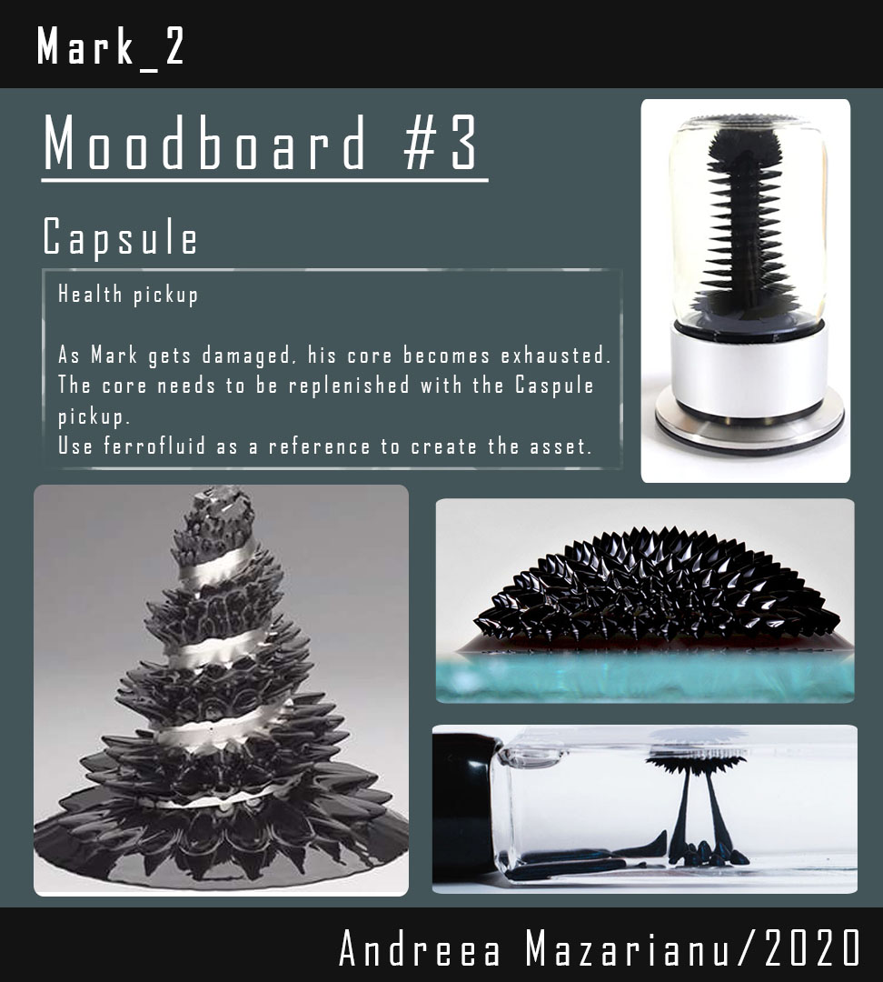
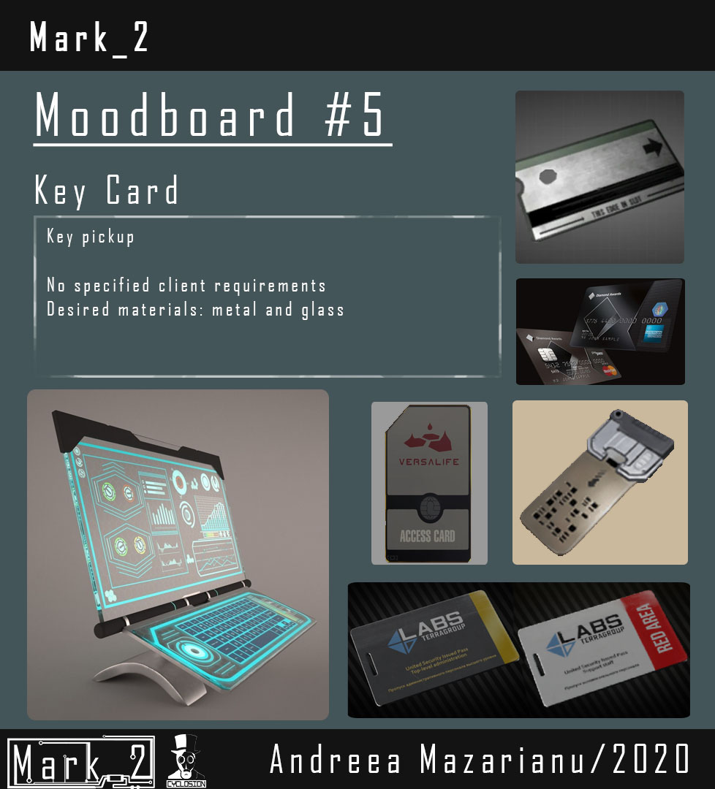
Moodboards

Slide 7
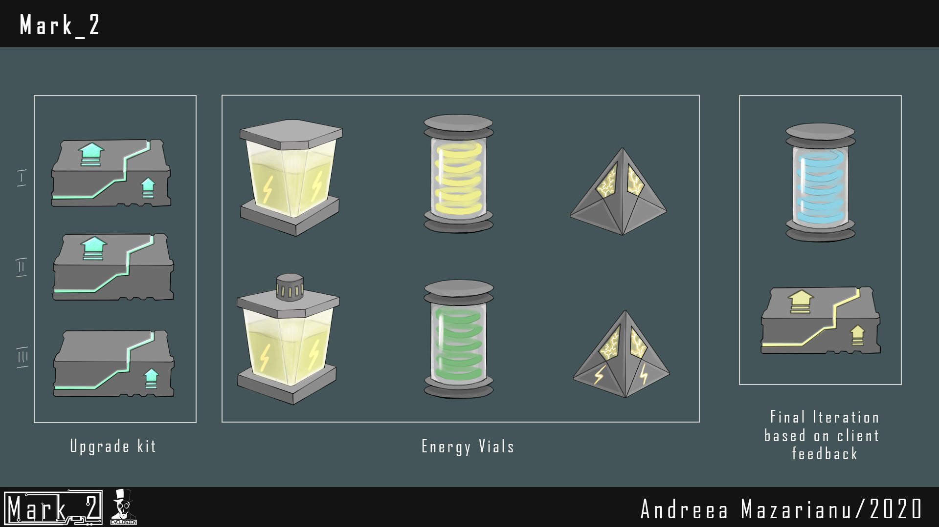
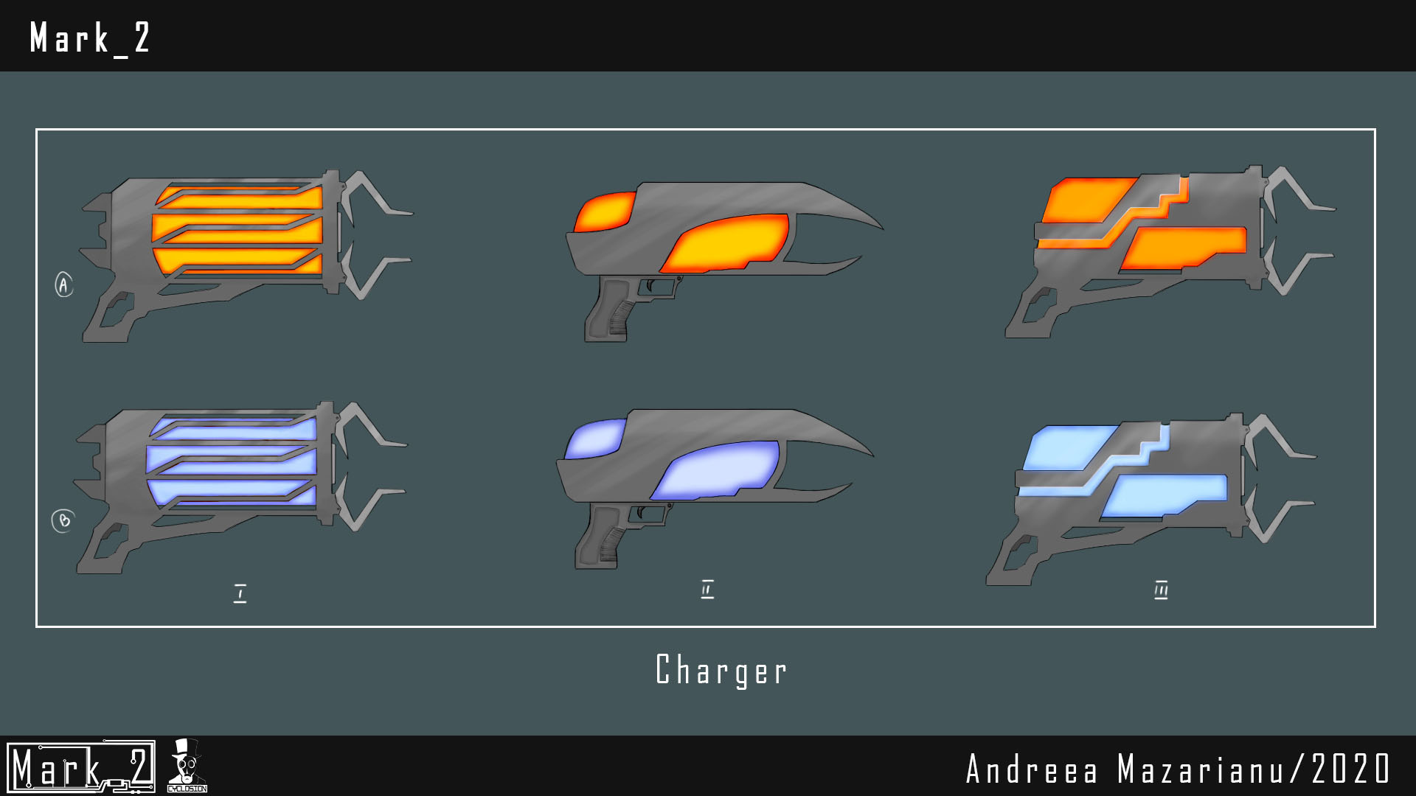
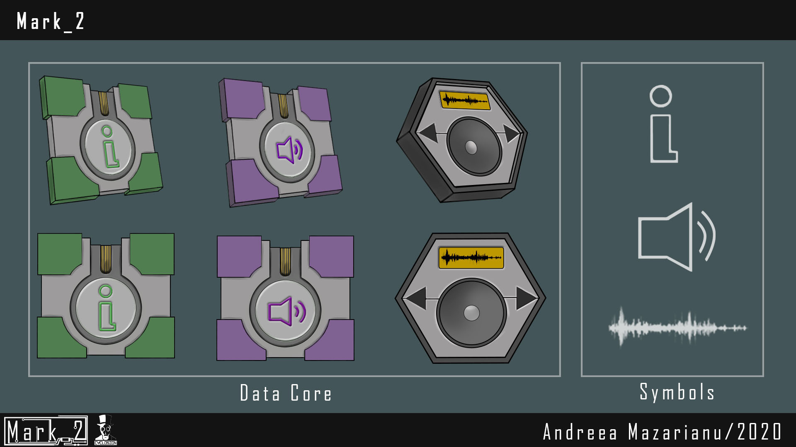
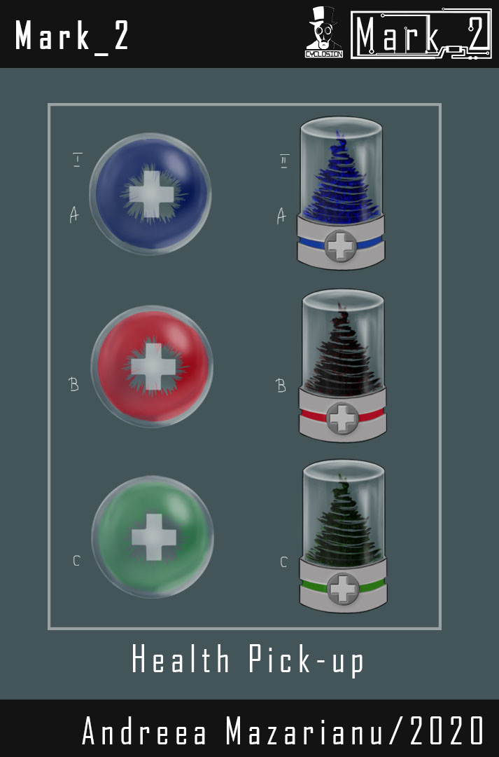
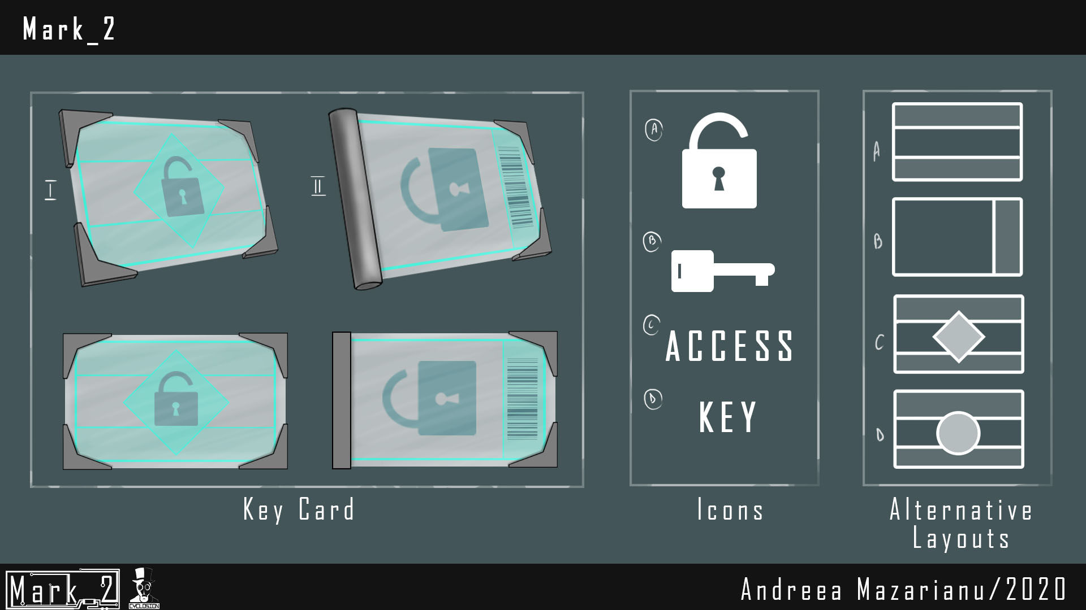
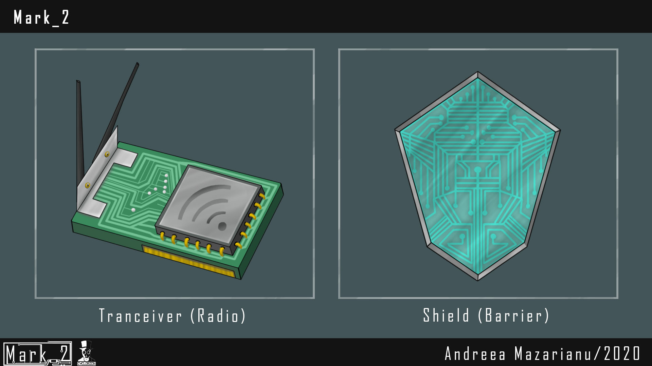
Pick-ups Concept Art

Slide 8
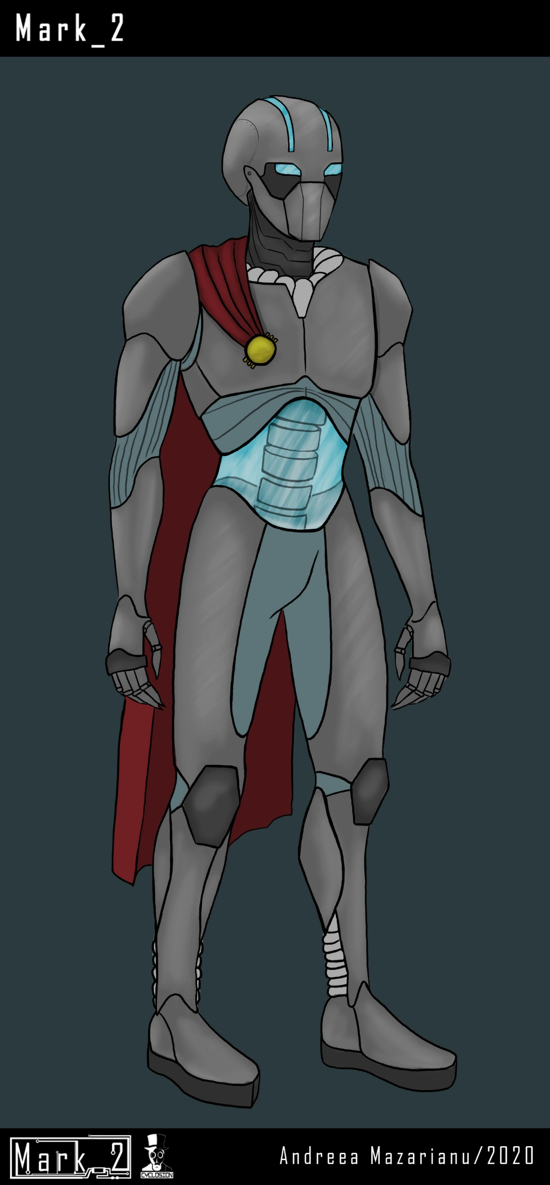
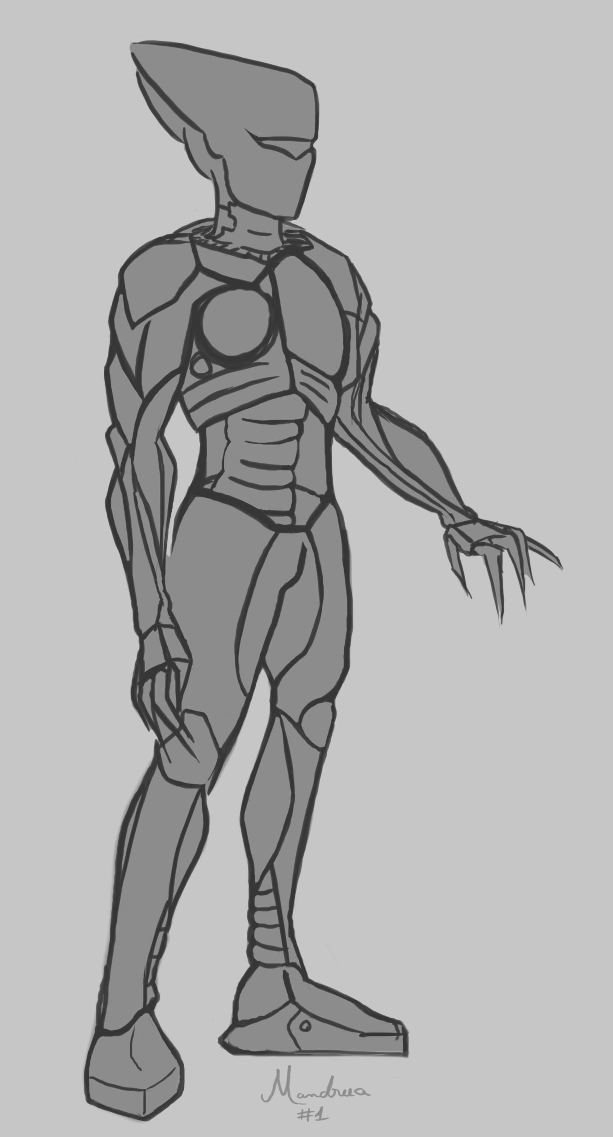
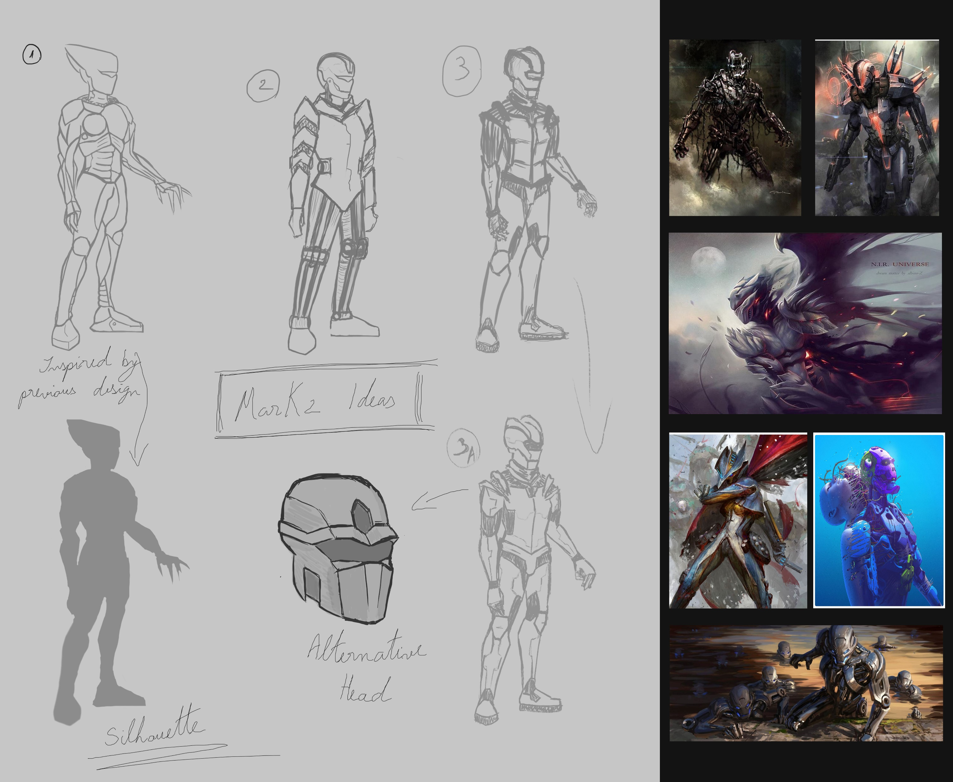
Main Character Concept Art

Slide 9
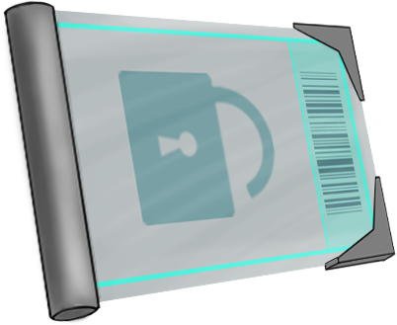
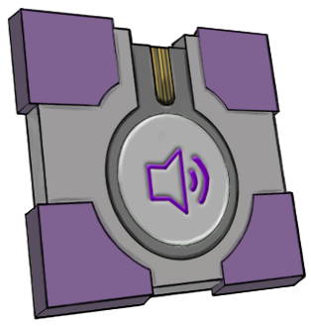
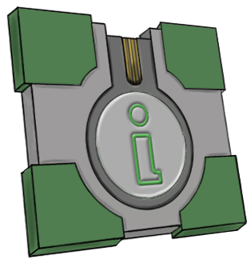
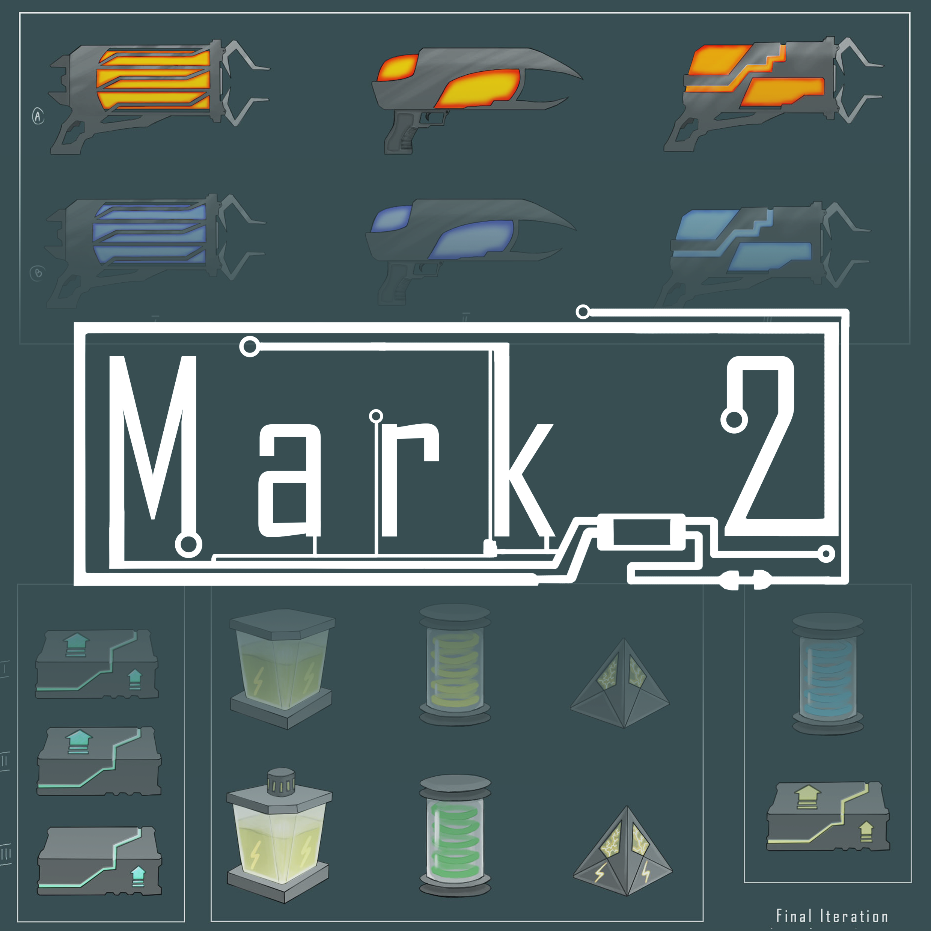

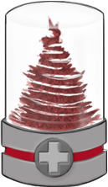
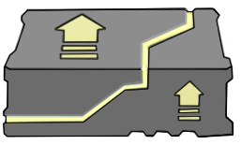
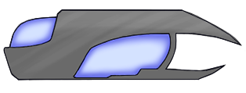
2D Sprites
Promo Art

Slide 10
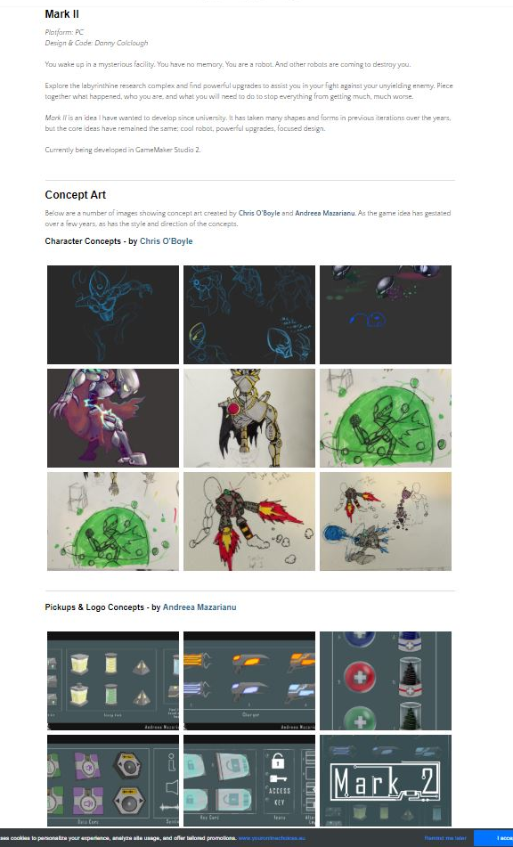
How did the produced work benefit the client?
Created a visualization of some of the future game elements – contributing towards the game design’s document
Game-ready 2D sprites
Provided promotional material to advertise the game idea

Slide 11
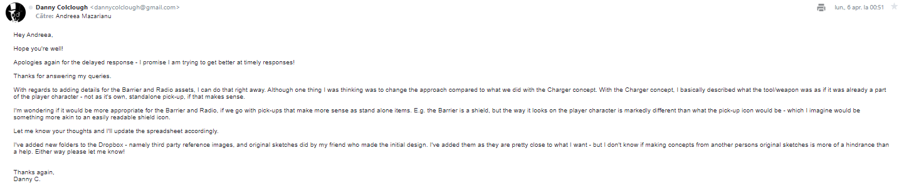
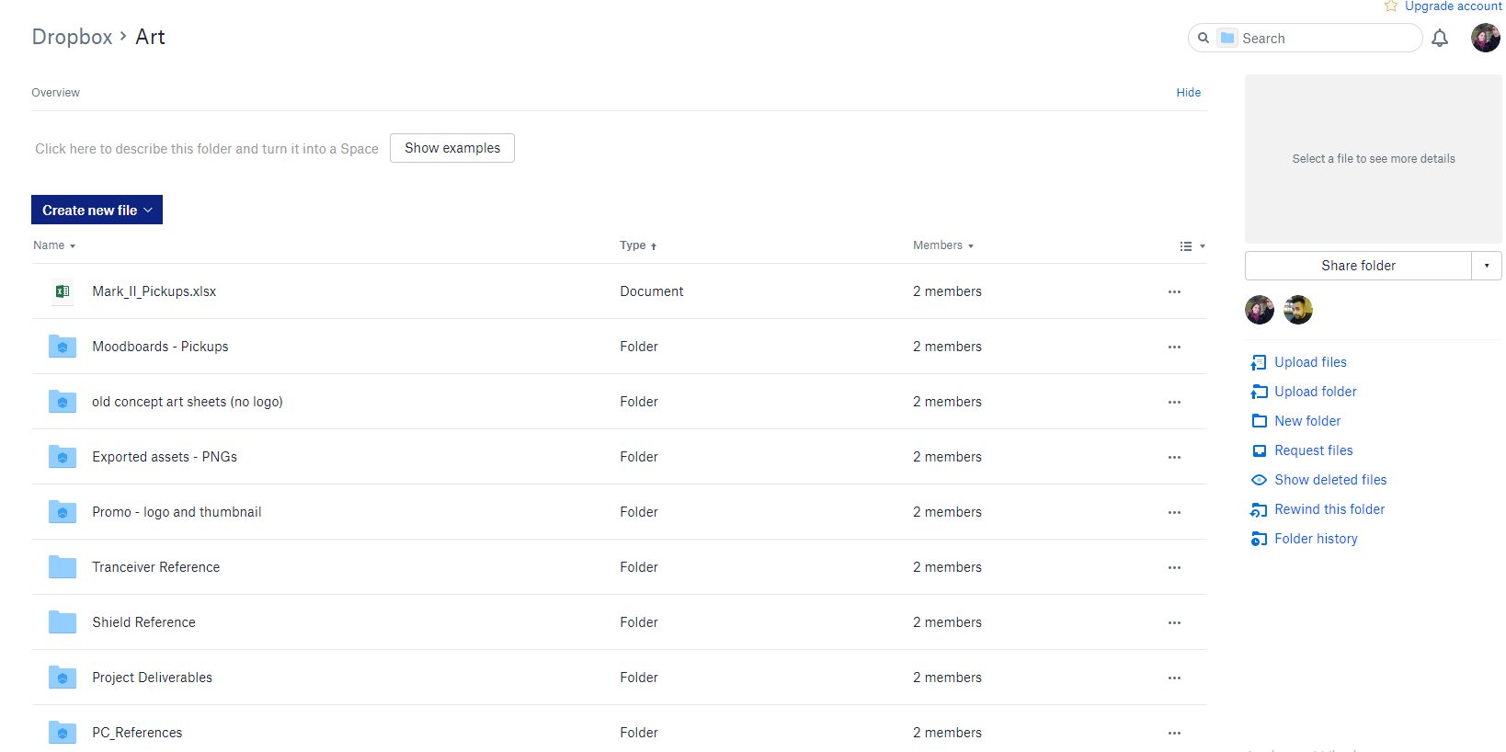
Communication
Communication: E-mail, Facebook Messenger, Discord
Sharing Files: Shared Dropbox
All communication recorded
as part of the meeting minutes
document

Slide 12
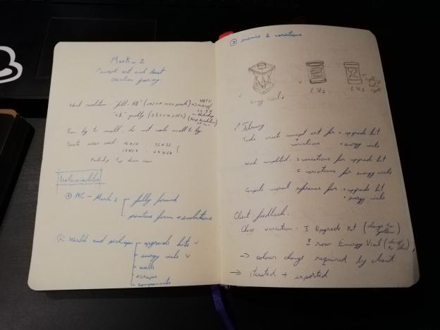
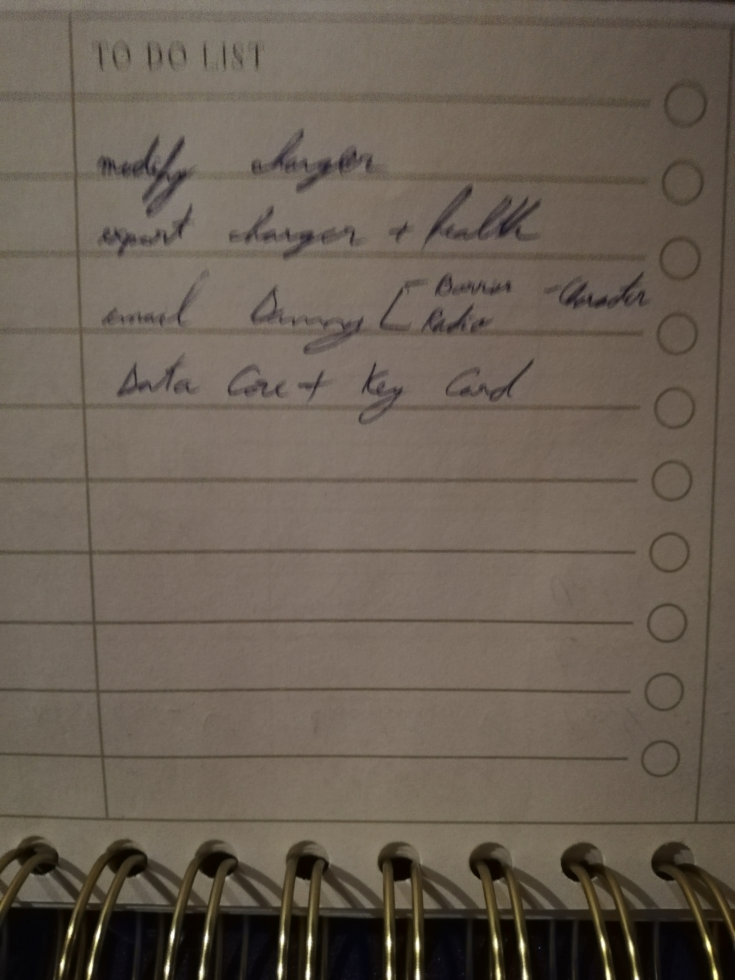
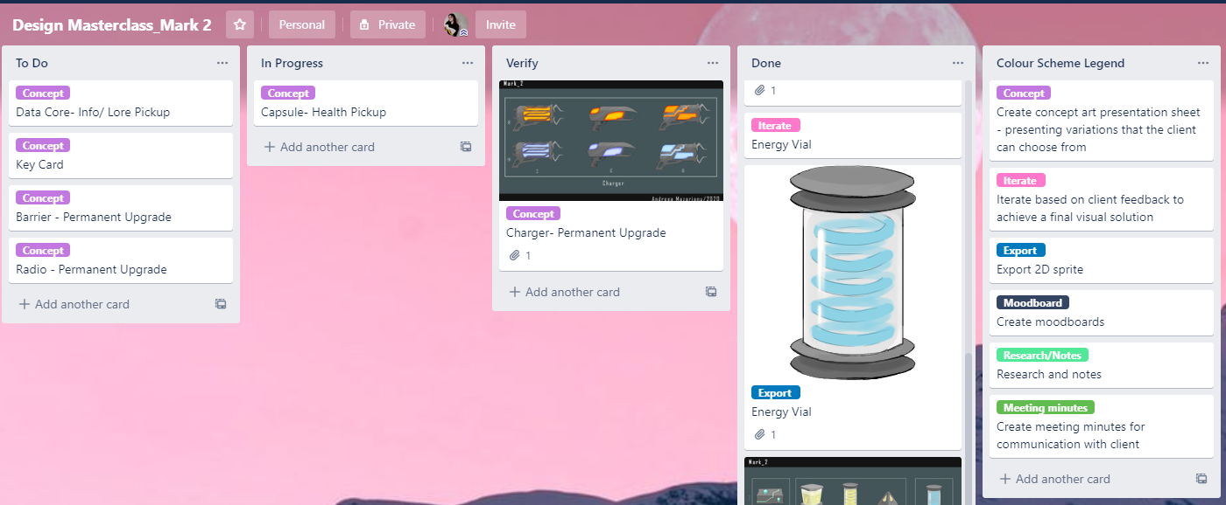
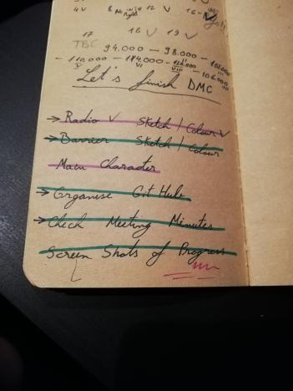
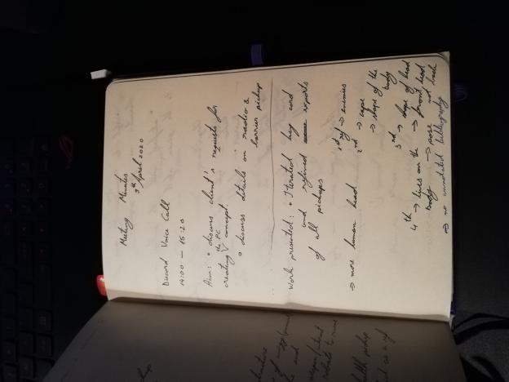
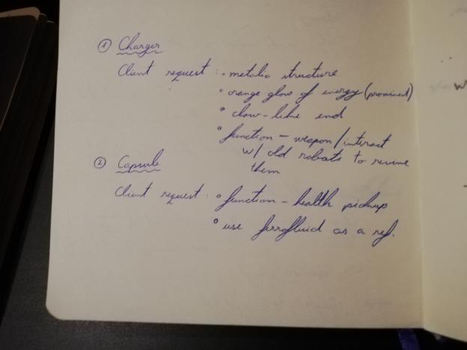
Self-management
Trello
To Do Written Lists
Meeting Agendas

Slide 13
Thank You!

